Slide 1

iNTELLIGENT HELMET FOR COAL MINERS
GROUP MEMBERS: GUIDED BY:
ANJANA P.U VIDHYA
KRISHNENDHU Asst. Professor,ECE Dept
SAJJATH
VISHNU BALACHANDRAN

Slide 2

OBJECTIVE
To provide greater security in coal mining, we are introducing a new technology that can be incorporated in the helmet used by coal miners which will act as “ INTELLIGENT HELMET FOR COAL MINERS”.

Slide 3
BLOCK DIAGRAM
TEMPRATURE SENSOR
PIC16F887
MICRO CONTROLLER
HUMIDITY SENSOR
BUZZER
GAS SENSOR

Slide 4
COMPONENTS | DESCRIPTION | SPECIFICATION
MICRO CONTROLLER | PIC16F887 | 40 PIN, 220uA (2.0V, 4MHz), 11uA (2.0 V, 32 KHz) 50nA
GAS SENSORS | CO2 AND METHANE SENSORS | MQ6
TEMPERATURE SENSOR | CALIBRATED IN CELSIUS | LM35
HUMIDITY SENSOR | SENSES THE HUMIDITY | 1 V, 0.22 MW, 0-60 ̊C

Slide 5
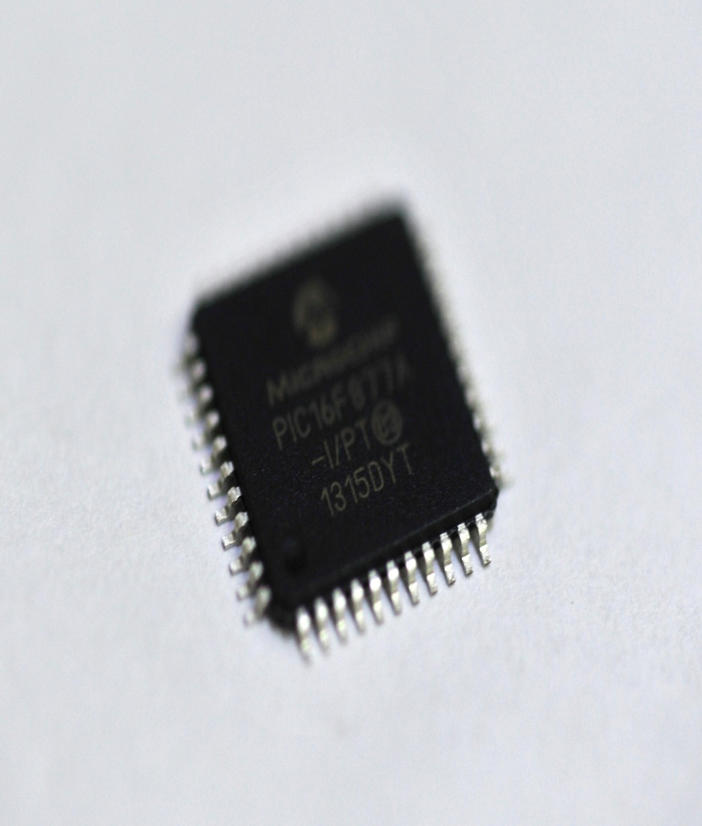
MICRO CONTROLLER PIC16F887
It is one of the latest products from Microchip. It features all the components which modern microcontrollers normally have. For its low price, wide range of application, high quality and easy availability, it is an ideal solution in applications such as: the control of different processes in industry, machine control devices, measurement of different values etc. Some of its main features are listed below.
RISC architecture
Only 35 instructions to learn
All single-cycle instructions except branches
Operating frequency 0-20 MHz

Slide 6
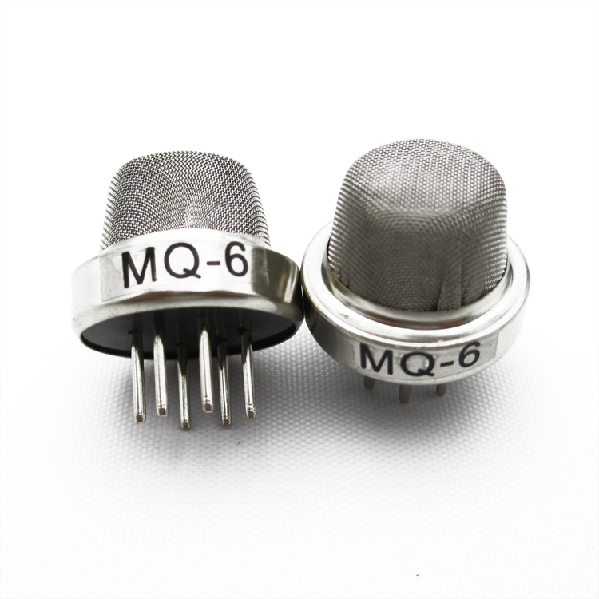
GAS SENSOR
Gas sensor is a device that detects the presence of gases like carbon monoxide, methane and other toxic gases and if exceeds the threshold limit produces an alarm through the buzzer. The common types of gas sensor are:
Ionization gas sensor MQ6
Photoelectric gas sensor
Photoelectric gas sensors are faster in detecting smoldering fires. Ionization gas sensors are better at detecting the flaming fires.

Slide 7
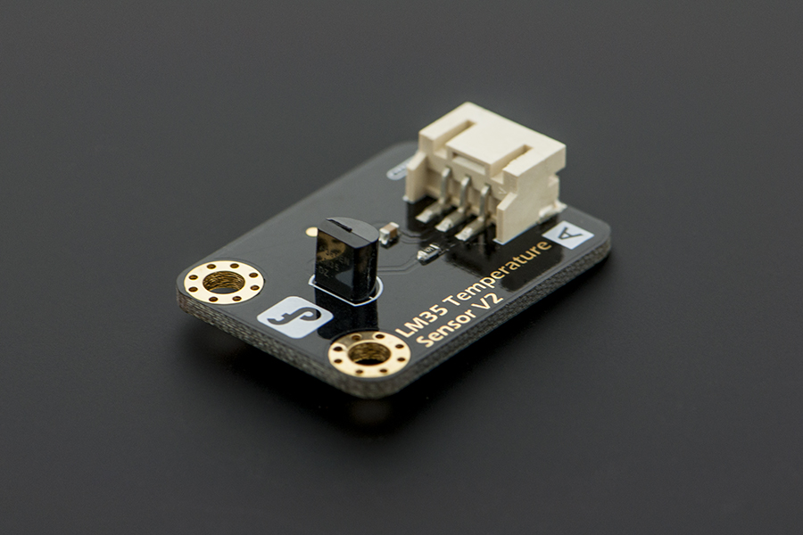
TEMPERATURE SENSORS
The LM35 series are precision integrated-circuit temperature sensors, whose output voltage is linearly proportional to the Celsius (centigrade) temperature. The LM35 thus has an advantage over linear temperature sensors calibrated in Kelvin, as the user is not required to subtract a large constant voltage from its output to obtain convenient scaling. The LM35 does not require any external calibration of trimming to provide typical accuracies of ±1/40C at room temperature and ±3/40C over a full -55 to -150C temperature range.

Slide 8
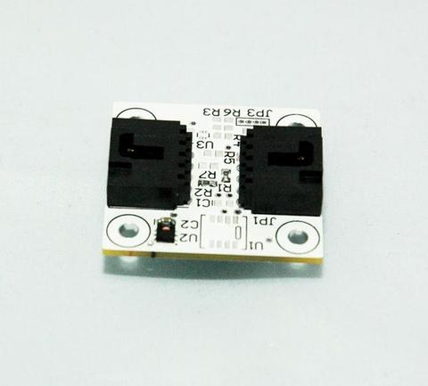
HUMIDITY SENSOR
Humidity sensors are gaining more significance in diverse areas of measurement and controlling technology. The amount of the water present in the air is nothing but the humidity. Humidity sensor used is SHT21.

Slide 9
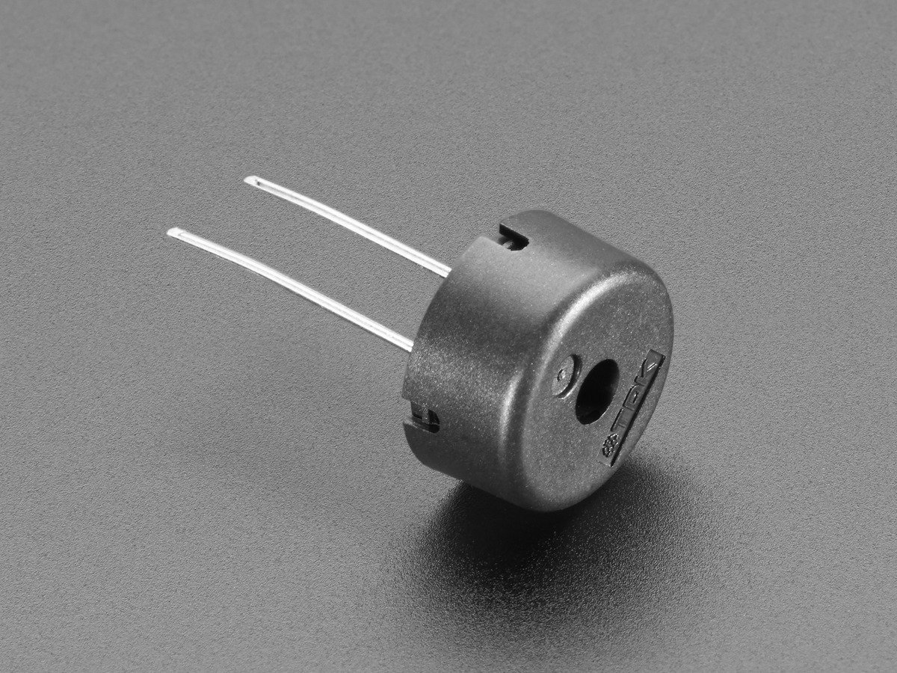
BUZZER
It is a signaling device, usually electronic, typically used in automobiles. It mostly consists of a number of switches or sensors connected to a control unit. These buzzers are available in lightweight compact sizes ranging from the smallest diameter of 12mm to large Piezo electric sounders. Today piezoelectric sound components are used in home appliances, audio equipment etc.

Slide 10
THANK YOU!!!!

